Slide 1

Anveshan 2024
Non Invasive Fetal Monitoring using ECG, EHG and clinical information
Theme: Maternal and fetal safety – Estimate fetal position during birthing process, reducing need for invasive exams.

Slide 2
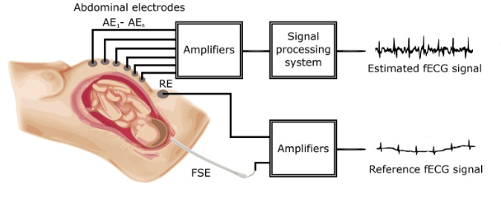
Problem Statement
Assumptions
Literature Review: Key Findings
Solution Description Overview
Summary :Teammates and Project
Solution Description: ECG
Block diagram and Workflow
Visualizations
Model overview
Solution Description: EHG
Block Diagram Description
Solutions and AUC probabilities
Hardware design (LLD, HLD and connectivity)
Leveraging the MAX78000 Board for Fetal Monitoring
End Users
Unique Selling Point (USP) / Market Differentiation
Conclusion
Table of Contents
Fig. 1: Block diagram of the experimental setup for fECG signal extraction and quality assessment
source: doi: 10.3389/fphys.2018.00648

Slide 3
Problem Statement
Problem We’re Solving
Significance and Impact:
Fetal cardiac anomalies, such as congenital heart diseases (CHD), affect 1 in 125 infants and are a leading cause of neonatal mortality. Existing methods like cardiotocograms (CTG) suffer from low signal quality and potential harm due to prolonged ultrasound exposure.
Preterm births account for 10% of live births globally, leading to neonatal mortality and long-term morbidity. Current predictive techniques, including cervical length measurement and fibronectin alpha testing, are either invasive, expensive, or lack accuracy, especially for asymptomatic mothers. This project addresses the need for a cost-effective, non-invasive solution to predict preterm births early.
Non-invasive FECG offers a safer alternative but faces challenges like low signal-to-noise ratio (SNR) and interference from maternal ECG.
The system has the potential to significantly reduce fetal morbidity and mortality by providing early warning signs of fetal cardiac anomalies, leading to timely medical interventions.
Accurate early prediction could allow healthcare providers to administer timely interventions, improving outcomes and reducing the burden on neonatal intensive care units (NICUs).
This project addresses the need for a cost-effective, non-invasive solution to predict preterm births early.

Slide 4
Literature Review: Key findings
For ECG Analysis
For EHG and clinical information Analysis
Fetal Electrocardiogram (FECG): Non-invasive FECG is preferred over CTG due to its ability to detect Fetal Heart Rate (FHR) and Fetal Cardiac Time Intervals (FCTIs). However, challenges include signal interference from maternal ECG (MECG) and noise.
Signal Processing: Techniques like ICA, Wavelet Transform, and SPWVD are used for FECG extraction. FastICA has been widely used but struggles with overlapping maternal signals. The SPWVD method improves SNR by analyzing signals in both time and frequency domains.
Machine Learning: SVM classifiers have proven effective in classifying pathologic vs. normal fetal conditions using features extracted from the FECG signals.
EHG Signals: Recent studies highlight the potential of abdominal EHG recordings to predict uterine contractions associated with preterm labor. These measurements are portable and non-invasive compared to traditional methods.
Deep Learning: Techniques like Recurrent Neural Networks (RNNs) and Bidirectional Long Short-Term Memory (BiLSTM) cells have demonstrated promise in extracting predictive features from EHG data.
Current Challenges: Previous attempts suffered from data leakage and overfitting, resulting in overly optimistic predictions. However, rigorous cross-validation and integration of clinical data can improve reliability.

Slide 5
Assumptions:
1. High-Quality Fetal ECG Data
Assumption: Five-minute multichannel fetal ECG recordings from five women in labor were used.
Justification: Data was collected at the Medical University of Silesia, Poland, using the KOMPOREL system. Each record includes four maternal abdominal signals and a reference fetal scalp ECG, sampled at 1 kHz with 16-bit resolution, between 38–41 weeks of gestation, ensuring high-quality signals for fetal ECG analysis.
2. Preprocessed EHG Datasets
Assumption: EHG data is derived from the TPEHG DB and TPEHGT DS datasets on Physionet.
Justification: These datasets, recorded at the University Medical Centre Ljubljana, include 159 records lasting 30 minutes each, taken from different mothers after the 26th week of gestation. Preprocessing excluded redundant records per mother to avoid bias, and only non-induced, non-Cesarean deliveries were included, ensuring robust and unbiased training data.
3. Hardware Design at Component Rating Level
Assumption: Specific component values for hardware (e.g., resistors, capacitors) are to be finalized during testing.
Justification: As a medical project, ethical clearance is required for human testing, which was unfeasible within the project timeline. Despite this, the hardware design meets medical standards and is ready for testing when clearance is obtained.

Slide 6
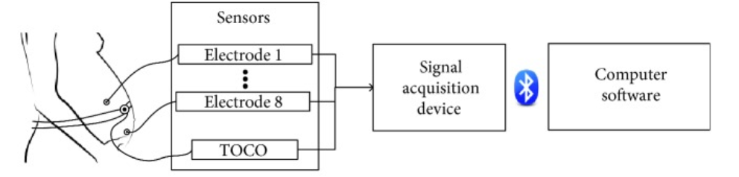
Signal Acquisition:
Combine ECG and EHG signal acquisition techniques. Use abdominal electrodes for both, ensuring accurate fetal and uterine activity monitoring.
Leverage preprocessing steps like bandpass filtering and noise elimination to enhance signal quality.
Signal Processing:
Use advanced techniques such as SPWVD and BiLSTM for feature extraction and classification.
Combine ECG features (e.g., HRV, QT interval) with EHG features (e.g., contraction frequency) for integrated analysis.
Prediction:
Employ SVM for fetal cardiac anomaly detection (from ECG).
Use BiLSTM for predicting preterm birth risk (from EHG).
Solution Description
Overview
Fig.2: Solution description overview
Source: doi: 10.3389/fphys.2018.00648

Slide 7
Anveshan 2024 Fellowship Executive Summary Team PUP, National Institute of Technology Calicut
Challenges in Fetal Monitoring: Existing methods, like CTG and fetal scalp electrodes, are invasive, uncomfortable, and error-prone. They lack genuine beat-to-beat heart rate (HR) measurements and can misinterpret data due to poor signal quality.
Clinical Need: There is a critical need for non-invasive, reliable methods to detect fetal anomalies and preterm birth risks early, preventing neonatal morbidity and mortality.
Literature Review
Signal Acquisition Techniques:
Method: Abdominal ECG acquisition using 12 electrodes placed on the maternal abdomen. Data were preprocessed with high-pass (1 Hz) and low-pass (150 Hz) filters.
Results: Achieved true beat-to-beat HR and HR variability (HRV), along with uterine electrical activity. Signal success rate was 80%.
Challenges: Excessive abdominal muscular activity and electrical interference impacted signal quality​
EHG-Based Monitoring
Method: Utilized EHG signals for non-invasive monitoring of uterine contractions.
Results: Showed that preprocessing EHG signals with bandpass filters (0.05–4 Hz) improves contraction detection.
Challenges: Signal noise and variations in electrode placement.
Fetal ECG Extraction : Signal Processing Techniques:
FastICA: For separating fetal ECG from maternal ECG and noise.
WCA: Traditional correlation-based maternal R-peak detection., SVM
SPWVD: Time-frequency domain analysis for precise feature extraction.
Key Metrics: Enhanced SNR, reduced RMSE, and high correlation coefficient
values with SPWVD being the most accurate​
EHG Signal Analysis : Signal Processing Techniques:
Short-Time Fourier Transform (STFT): For extracting temporal features from EHG.
BiLSTM Model: For predicting preterm birth risks.
Accuracy: BiLSTM outperformed traditional statistical models in predicting outcomes.
ADI mentor : Akshaykumar Hari Bhatt
Faculty Mentor: Dr. Subha D.P
Students:
1. Unnati : Final Year EEE student
2. Piyush Soni: Final Year ECE student
3. Pramod Kumar : Final year EEE student
This project was a rewarding journey that combined signal processing, machine learning, and hardware design for a non-invasive fetal monitoring solution. Overcoming challenges like complex datasets and ethical constraints enhanced our technical skills and highlighted the impact of technology in advancing healthcare solutions.
Duration of the project: 4 months
Efforts spent on the project : 10 hrs/ week
SOLUTION SUMMARY
TEAM MEMBERS

Slide 8
Solution Description : ECG
The system processes AECG signals through multiple stages:
Acquisition of abdominal ECG signals.
Pre-processing to remove noise and artifacts.
FECG extraction using techniques like FastICA, WCA, and SPWVD.
Post-processing to enhance signal quality.
Feature extraction from FHR and FECG to identify abnormal patterns.
Classification of normal vs. pathologic fetal conditions using an SVM classifier.
Methodology
Data Acquisition
Input Data
Source: Signals recorded as multichannel data in European Data Format (EDF) files.
Signal Types: Maternal and fetal electrocardiograms (ECGs) mixed with background noise.
Sampling Rate: 1000 Hz for high temporal resolution.
Tools and Libraries
PyEDFlib: Used for reading and parsing EDF files to extract abdominal ECG signals.
NumPy & SciPy: Employed for signal manipulation and preprocessing.

Slide 9
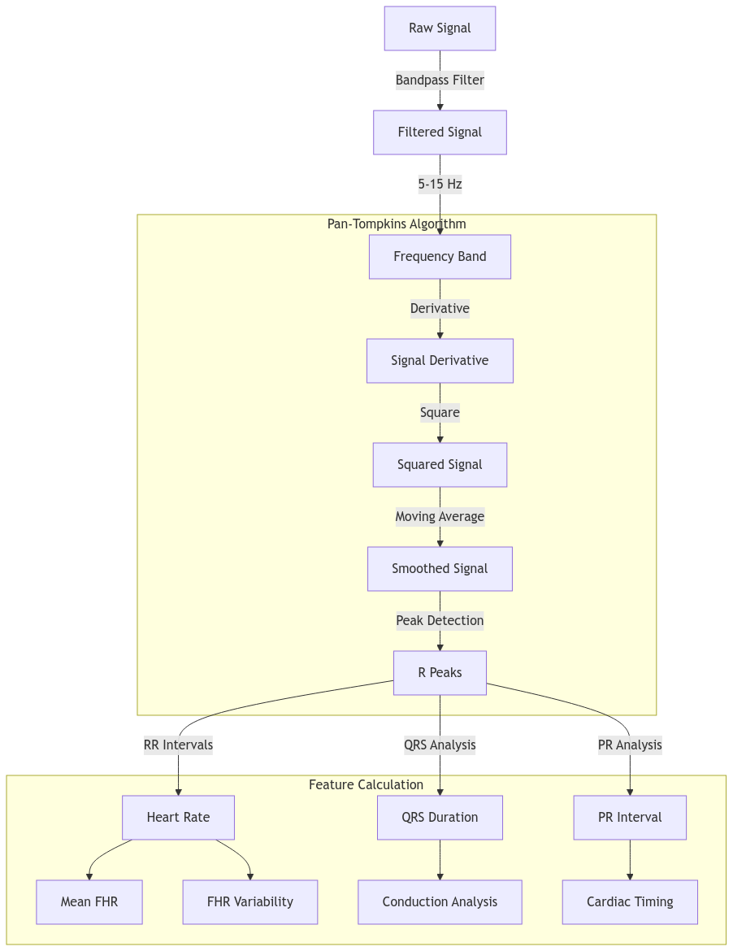
Block Diagram & Workflow: ECG
Clinical Indicators
Derived features were used to classify cardiac conditions:
Tachycardia: FHR > 160 bpm.
Bradycardia: FHR < 110 bpm.
Abnormal QRS: Duration > 75 ms.
Prolonged PR Interval: Duration > 166 ms.
Anomaly Detection
An SVM model was trained on extracted features to classify normal and anomalous FHR patterns.
Label Assignment
Labels were assigned based on clinical thresholds:
Tachycardia, bradycardia, prolonged QRS, or abnormal PR intervals.

Slide 10
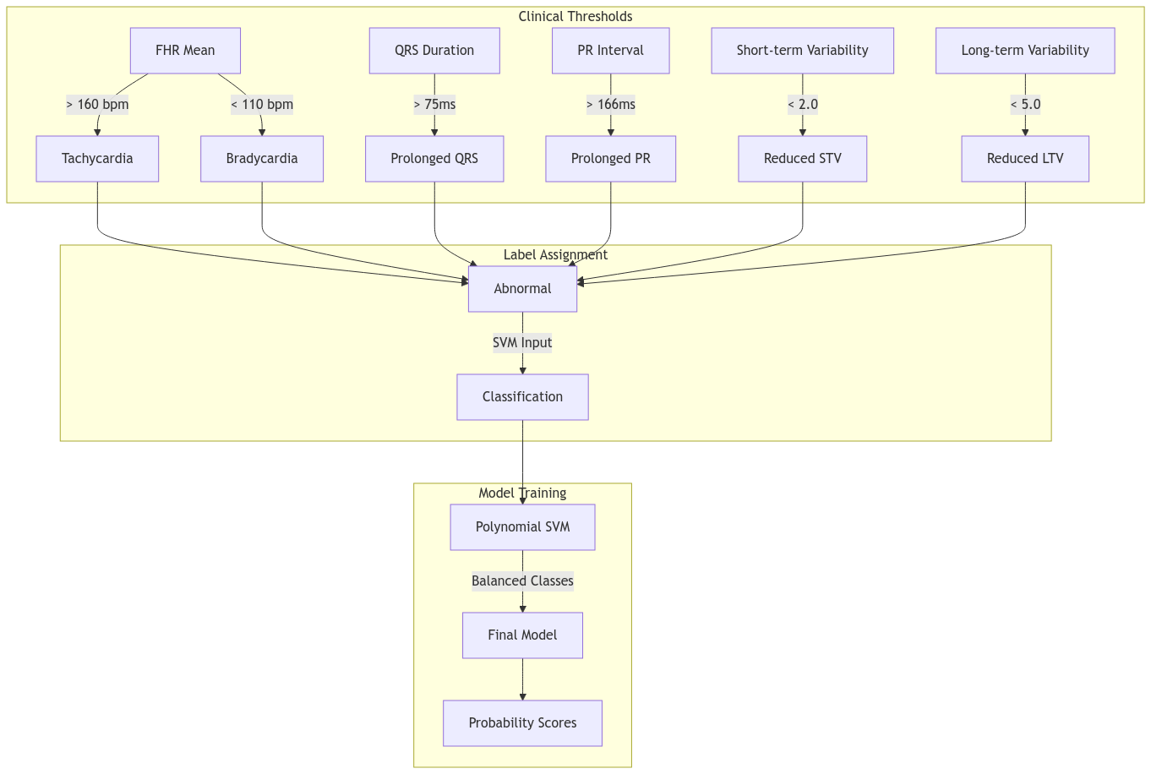
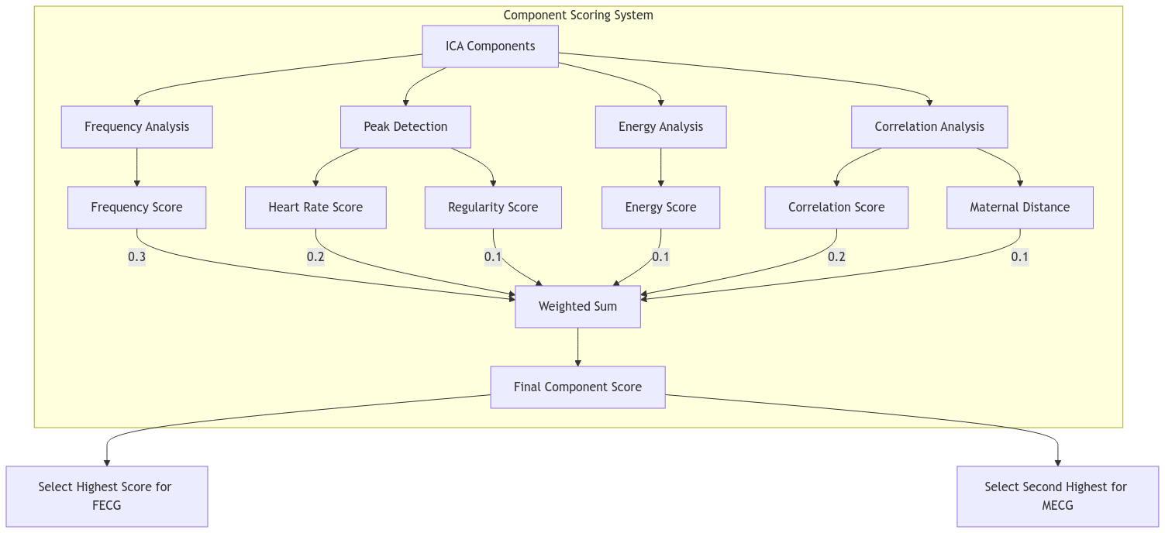
Clinical
Indicators
Visualization of FHR trends and Maternal and Fetal Components:

Slide 11
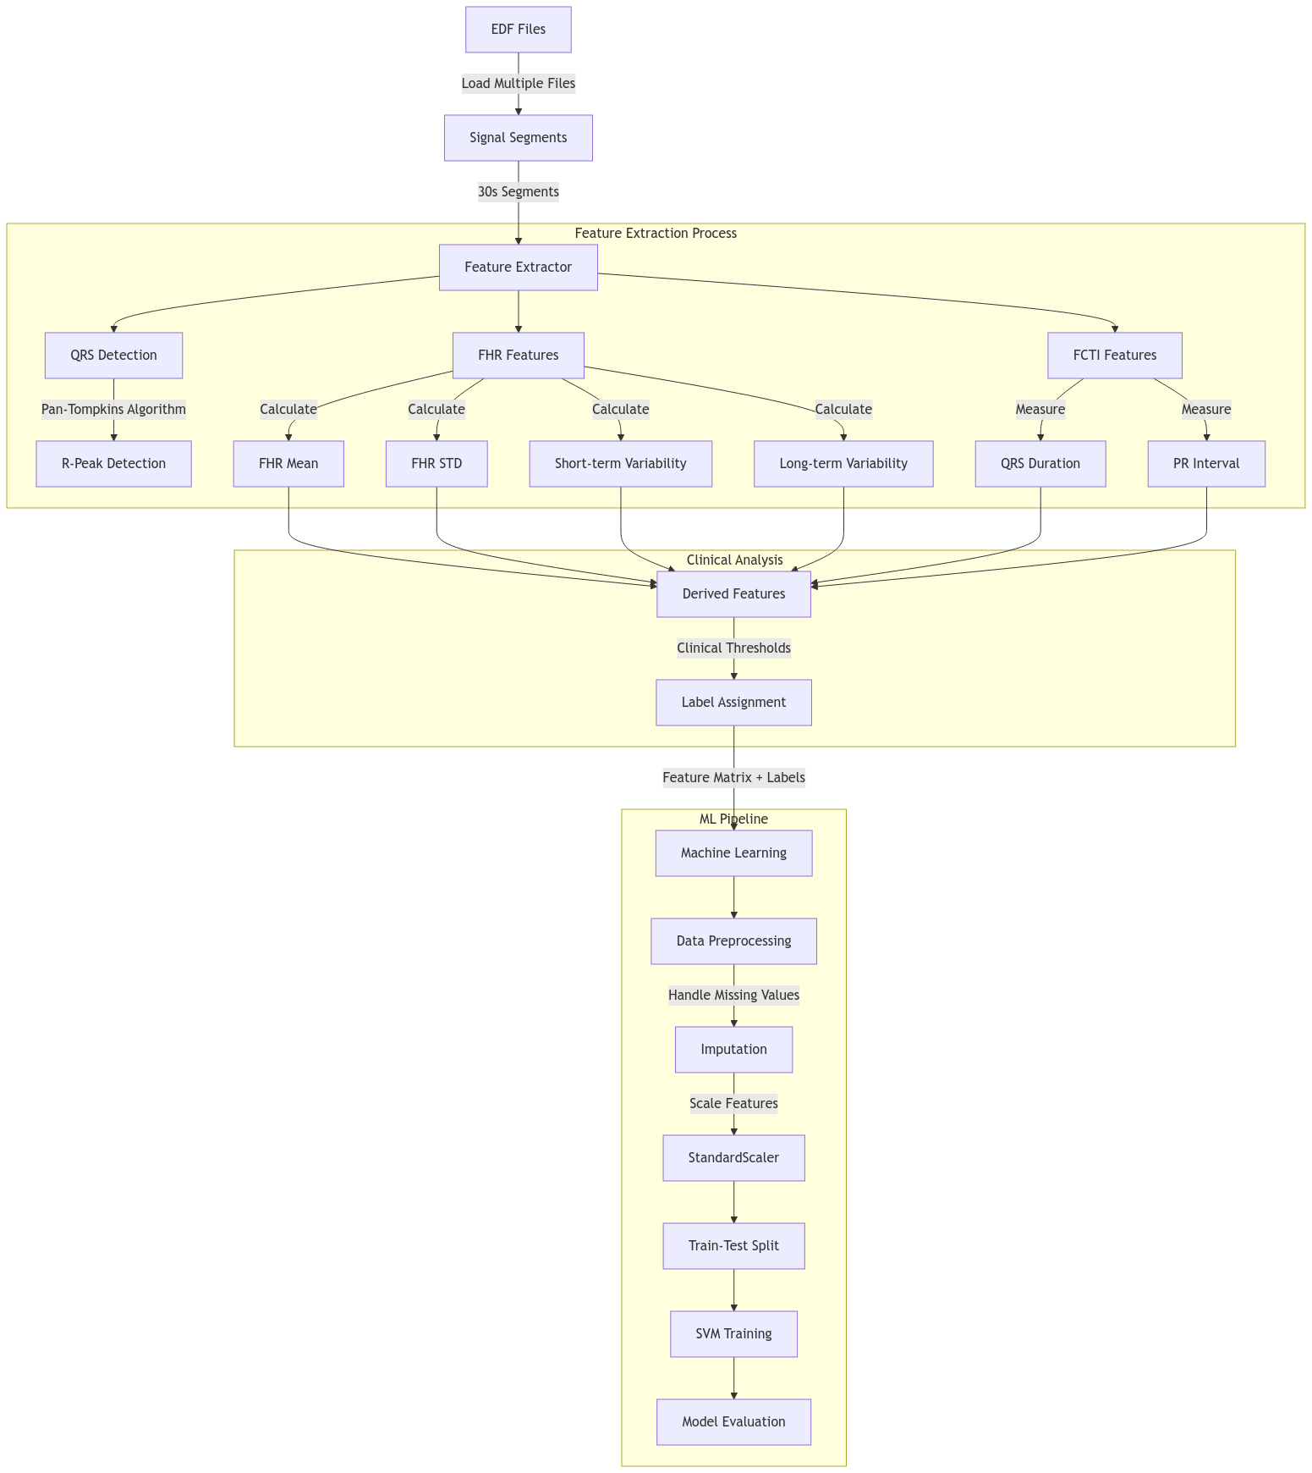
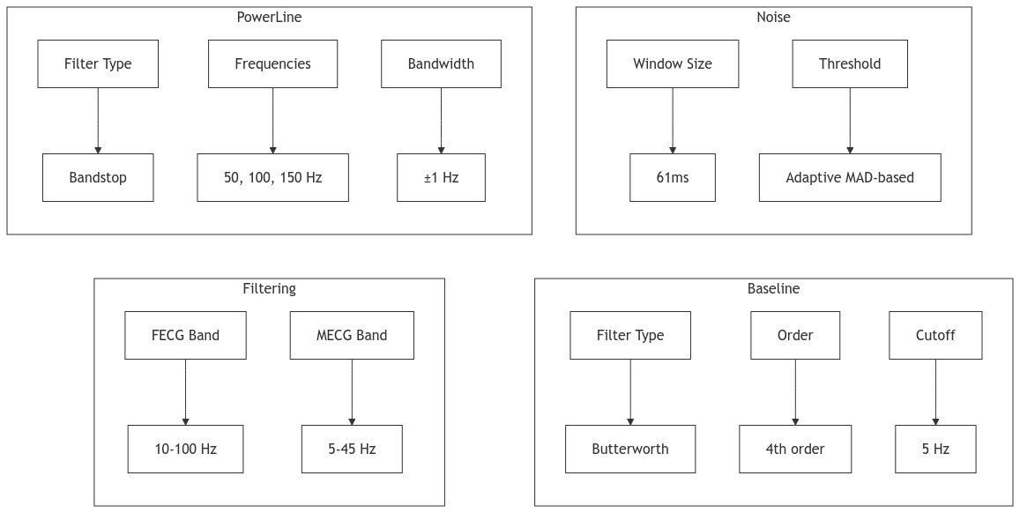
Model Overview
Noise and Artifact Removal
Impulse Noise:
Adaptive median filtering was applied to identify and correct impulse spikes based on an estimated noise level using the median absolute deviation (MAD).
Baseline Wander:
A low-pass Butterworth filter with a cutoff frequency of 0.5 Hz removed low-frequency baseline drift caused by respiratory movements.
Power Line Interference:
A series of bandstop filters were designed to remove power line frequencies at 50 Hz and its harmonics (100 Hz, 150 Hz).

Slide 12
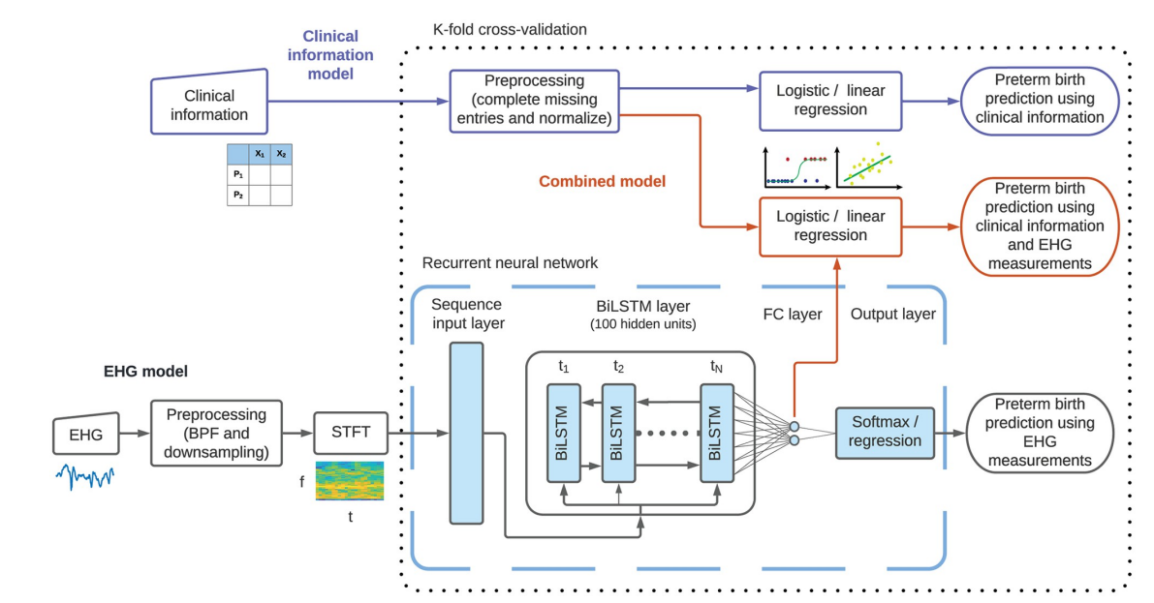
Solution Description : EHG
Develop a deep learning model that combines:
Preprocessed EHG signals (bandpass filtered and transformed using STFT).
Clinical data (e.g., gestational age, maternal history).
The model predicts preterm birth probabilities and offers actionable insights for clinical use.
Fig.3: Block diagram of the three classification and regression models used
Source:https://doi.org/10.1371/journal.pone.0285219.g001

Slide 13
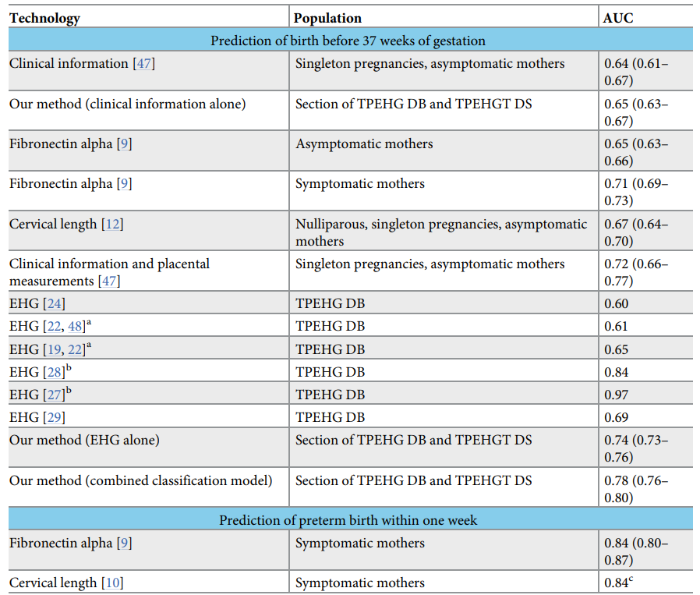
Block Diagram Description: Classification and Regression Models
Models used
Findings : Accuracy predicted
Clinical Information Model (Upper Part - Blue Outlines)
Input: Tabular clinical data.
Preprocessing: Missing entries completed, predictors normalized.
Model: Logistic or linear regression (blue block with schematic illustration).
Output: Prediction of preterm births based on clinical features.
EHG Model (Lower Part - Black Outlines)
Input: EHG measurements.
Preprocessing: Bandpass filtering (BPF) and downsampling.
Feature Extraction: Computation of STFTs (black-outlined block with schematic).
Model: RNN with:
Input layer.
BiLSTM layer.
Fully connected (FC) layer.
Output layer (light blue shapes with black outlines, enclosed in dashed light blue outline).
Output: Predictions based on EHG features.
Combined Model (Middle Part - Red Outlines)
Inputs: Clinical information and EHG measurements.
Model: Integrated system combining both modalities for enhanced prediction of preterm births.
Cross-Validation (Dotted Black Outline)
Indicates operations applied separately for each data partition (inside the outline) and operations applied globally to all data (outside the outline).
Table 1: .Accuracyofseveraltechnologiesandmethodstopredictpretermbirths.

Slide 14
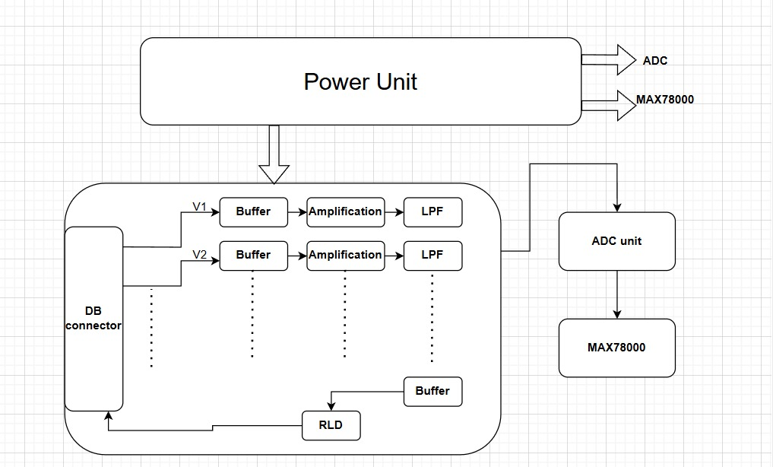
Hardware design
Hardware testing and physical setup required ethical clearance and a huge budget. We’ve documented detailed requirements for design and determined ranges for which exact resistive and capacitive values can be calculated at testing.
Fig.4: Block diagram of the Hardware design for acquisition and Filtering

Slide 15
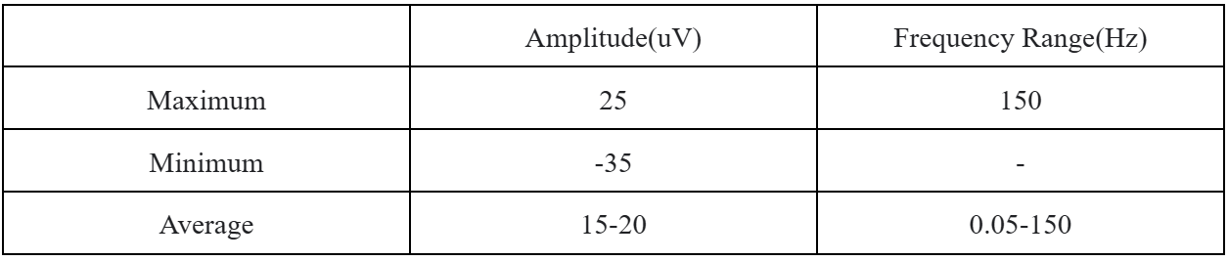
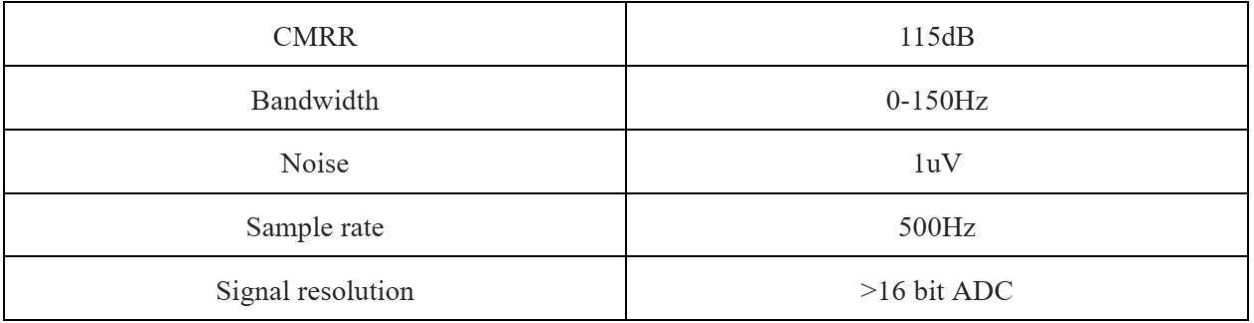
ECG specifications & Requirement:
ECG features from the dataset:
Specifications Required for ECG sensor:

Slide 16
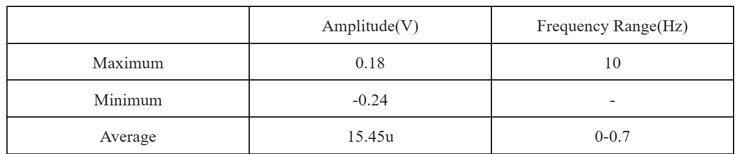
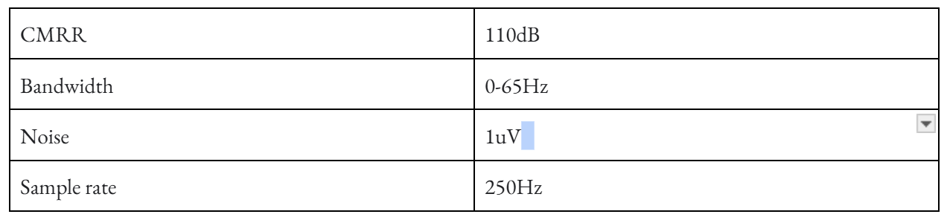
EHG specifications & Requirement:
EHG features from the dataset:
Specifications Required for EHG sensor:

Slide 17
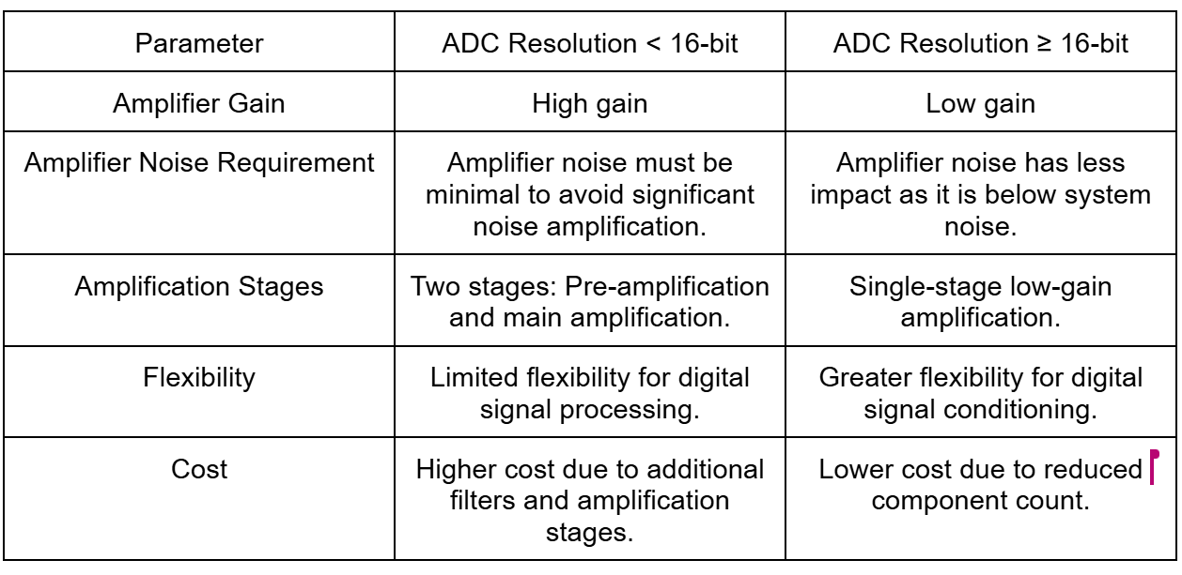
Amplifier for the Sensor:
Designing analog front end for the ECG/EHG will be strongly influenced by the resolution of the ADC used , based on the resolution two approaches can be taken :
If the resolution is less than 16-bit then, low noise amplifier with high gain should be used.
If the resolution is more than 16-bit then, low gain amplification method is preferred
The design consists of 2 parts:
Power unit
Analog front end

Slide 18
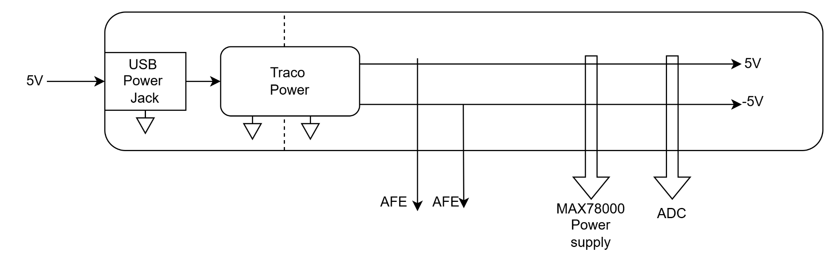
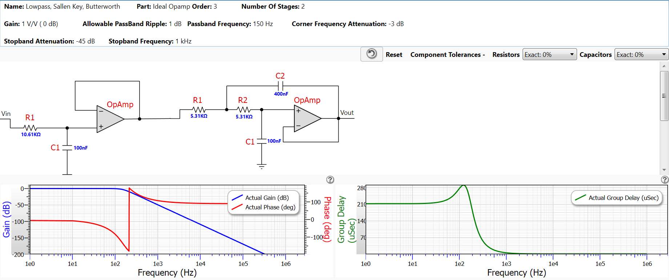
Power unit
The AFE can be divided into 3 major blocks which includes:
The input buffer stage
Amplifier
LPF
Based on the specifications mentioned above AD8624 is best suited for the input buffer stage of both ECG and EHG.
For the amplifier stage either a digitally Programmable Instrumentation Amplifier (AD8231) can be used however the CMRR for this is low than required, so LTC6915 is a more suitable choice for digitally Programmable Instrumentation Amplifier,but if non -programmable Instrumentation Amplifier is used than we can use AD8426.
The advantage with Programmable Instrumentation Amplifier is that we can easily tune it to our setting for both ECG and EHG, however that comes with additional cost than simply using the non-programmable ones.
The 3rd stage is the LPF for removal of the high frequency noise as described above for the ECG its range is in 0-150Hz and for EHG it is between 0-65Hz
Shown below is a design for the 0-150 Hz LPF:

Slide 19
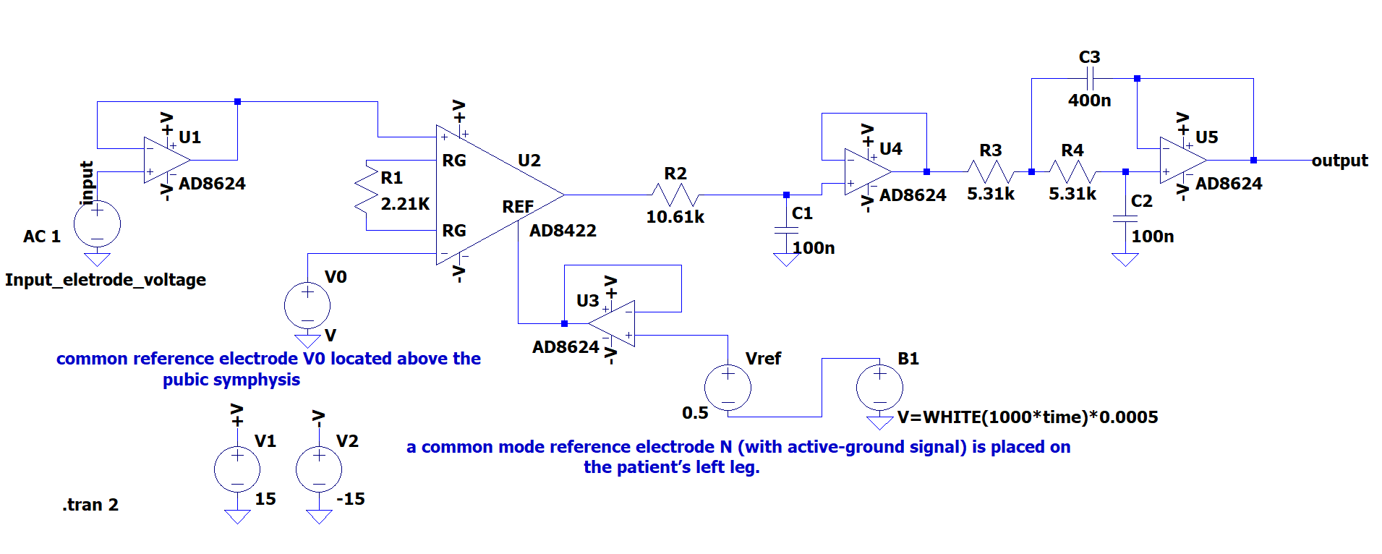
LtSpice Simulation
Fig.4:SPICE simulation schematic

Slide 20
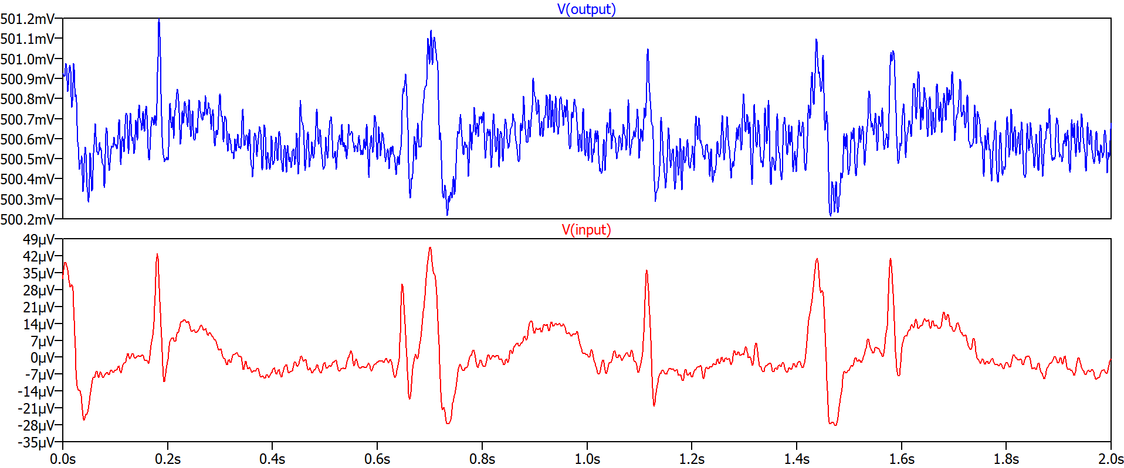
Simulation Results:
Fig.5:.Input & output voltages

Slide 21
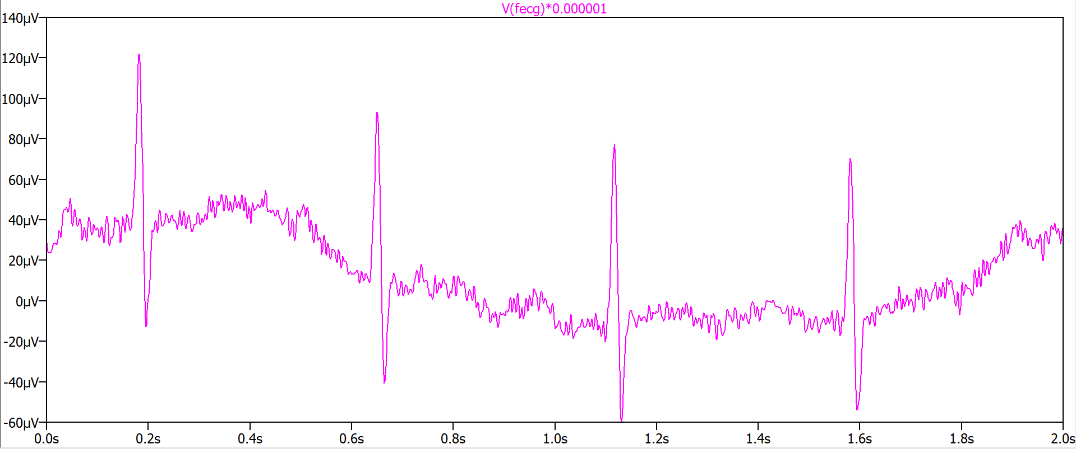
Simulation results (contd.): A comparison
Fig.6: Direct FECG signal

Slide 22
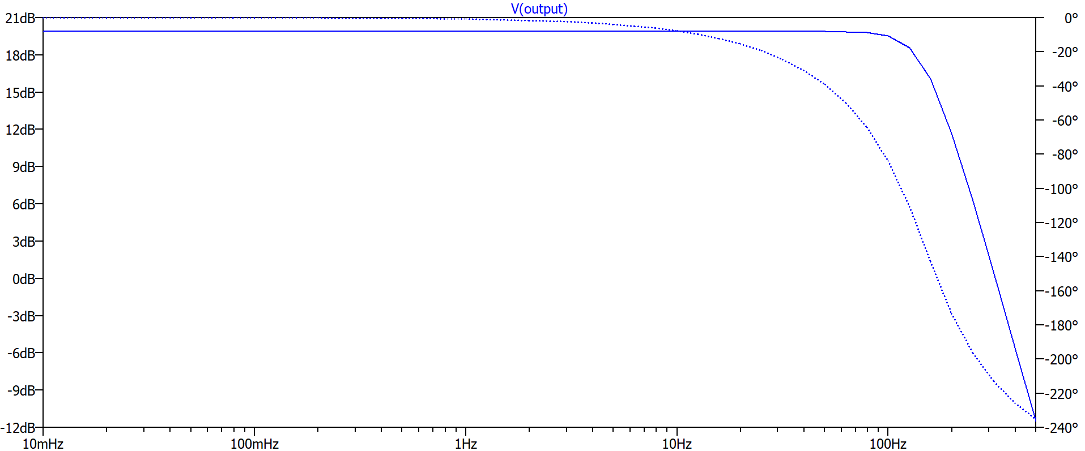
Bode Plot:
Fig.7: Frequency domain analysis

Slide 23
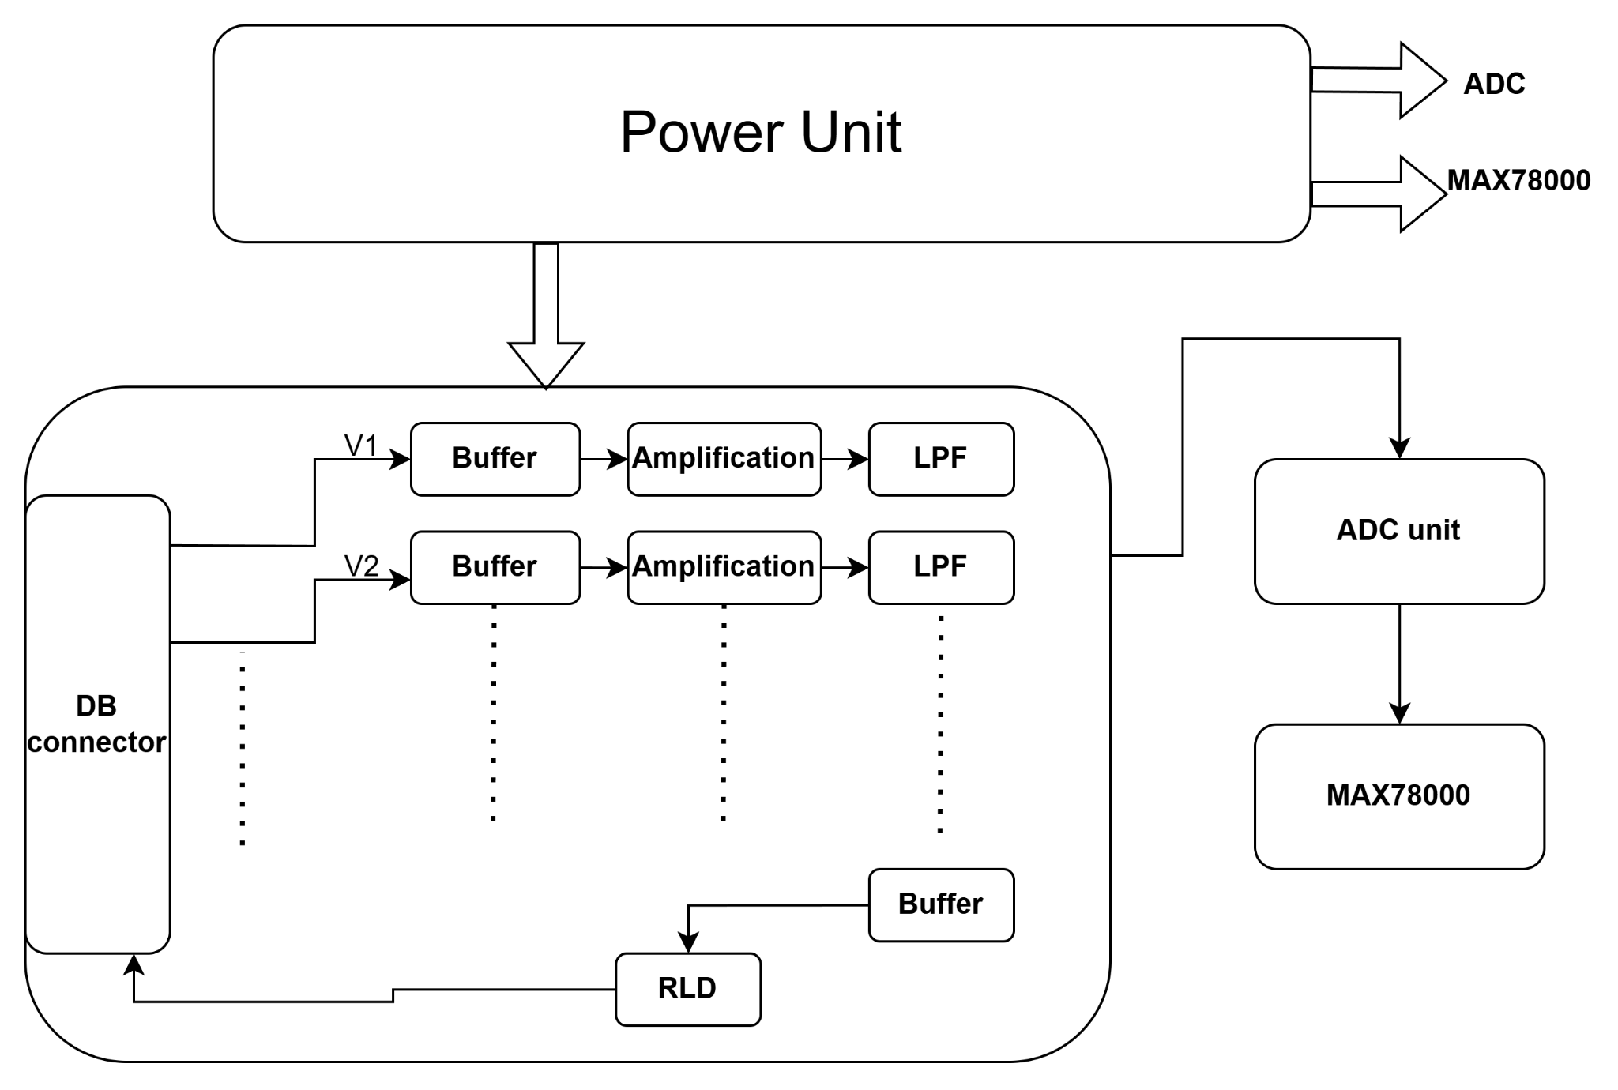
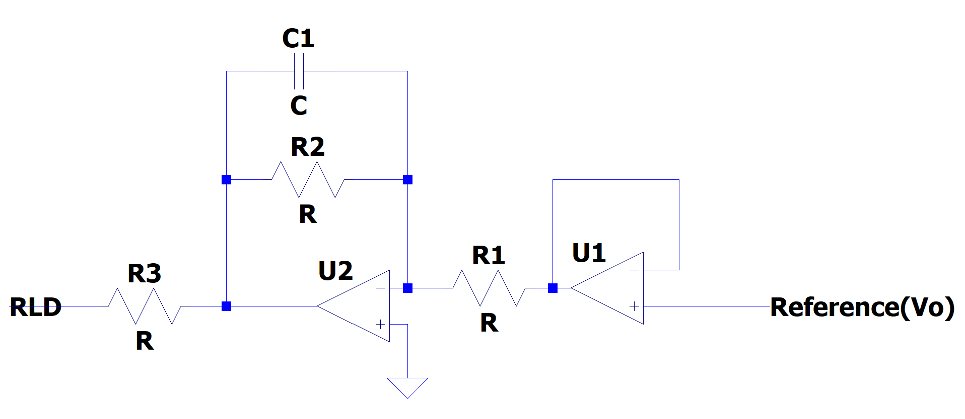
Hardware design continued
RLD circuit:
Complete board circuit

Slide 24
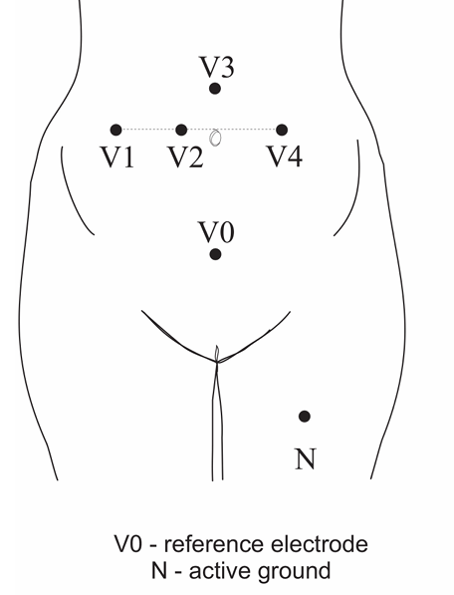
Of the four abdominal channels, Abdomen_1 and Abdomen_2 configurations provided higher-quality fetal signal extraction compared to Abdomen_3 and Abdomen_4, which were more prone to interference and less reliable at lower gestational ages or in cases of fetal movement​.
Other considerations for the ECG sensor:
If strong low-frequency noise occurs, the cut-off frequency of the digital high-pass filter increases to 1Hz.
For abdominal signals sum of low frequency, power line and muscle interferences is assumed as noise.
Muscle interferences are generated mainly by abdominal muscles, and they also result from the contraction activity of the uterus.
Low-frequency and power line interferences are basically suppressed during preliminary signal filtering. However,muscle interferences are much more difficult to suppress because in a wide frequency range they coincide with the FECG signal.
Electrode placements -ECG
Fig.8: Electrode placement system for recording and analysis of bioelectric signals acquired from the maternal abdominal wall,the direct electrode attached the fetus head(sampling rate of 1 kHz,bandwidth 1Hz–150Hzandresolutionof16bits).
Source: https://doi.org/10.3389/fphys.2018.00648

Slide 25
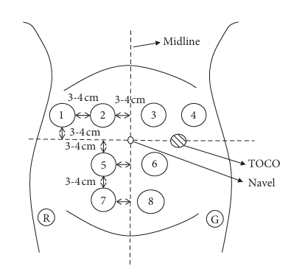
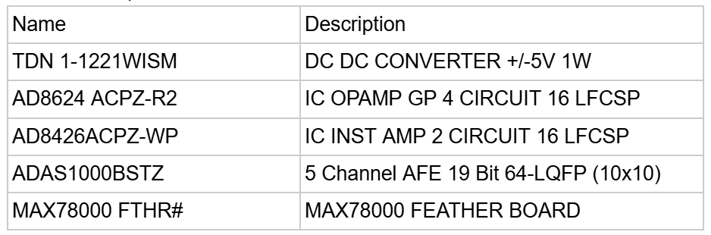
EHG electrode placement
From the data set the S2 electrode setting(2-7) was best suited for capturing the UC , as shown in above figure .
S2 (Vertical Activity): It measures the EHG signal between the left two electrodes, capturing vertical electrical activity of the uterus. This positioning is likely to reflect more consistent uterine muscle contractions, as the vertical direction aligns with the dominant contraction wave propagation in the uterine muscles during labor.
Components list :
Fig.9: EMG placement of electrodes
Source: DOI 10.1007/s11517-008-0350-y

Slide 26
Purpose:Enable real-time processing of EHG and ECG signals in a non-invasive fetal monitoring system.
Functions in the System:
Signal Preprocessing: Filters noise from EHG and ECG data streams.
Feature Extraction: Computes STFTs and extracts key signal features on-device.
Neural Network Acceleration: Runs BiLSTM and regression models efficiently for classification and prediction.
Low-Latency Predictions: Processes input and delivers anomaly detection or preterm risk outputs in real-time.
Role in the Project
Portability: Supports integration into compact, wearable devices for home or clinical use.
Energy Efficiency: Ultra-low-power design allows continuous operation, crucial for prolonged monitoring sessions.
Scalability: Onboard neural network acceleration enables deployment of advanced algorithms without cloud dependency.
Benefits
Real-Time Monitoring: Enables faster decision-making in critical scenarios.
Edge AI Processing: Reduces reliance on external servers, ensuring privacy and reliability.
Cost-Effectiveness: Lowers system costs by consolidating processing tasks into a single device.
Improved Accessibility: Facilitates fetal monitoring in remote or low-resource settings.
Leveraging the MAX78000 Board for Fetal Monitoring

Slide 27
Who are the End Users?
Healthcare Providers:
Obstetricians, gynecologists, and maternity care units.
Use the system to monitor fetal health and detect anomalies or risks in real-time.
Expectant Mothers:
At-home monitoring during pregnancy, reducing the need for frequent clinical visits.
Researchers:
Access to advanced data for studying fetal health patterns and improving predictive models.
Benefits to Users
Healthcare Providers:Early detection of fetal anomalies enables timely interventions, reducing complications.
Expectant Mothers: Reassurance through real-time updates on fetal health, with improved convenience.
Researchers: Provides reliable datasets for exploring new healthcare solutions.
End Users

Slide 28
How is Our Solution Unique?
Non-Invasive Monitoring:
Combines EHG and ECG techniques to provide safer alternatives to invasive methods.
Real-Time Analysis:
Leverages on-device AI for immediate results, minimizing delays and data dependency.
High Accuracy:
Advanced algorithms (BiLSTM, SPWVD) ensure reliable predictions of preterm birth and fetal anomalies.
Portability:
Compact, energy-efficient design suitable for home and clinical environments.
Market Differentiation
Unlike existing methods (e.g., cardiotocography or fetal scalp electrodes):
Safer: Eliminates risks of infections and trauma.
Cost-Effective: Reduces overall system costs with edge AI processing.
More Accessible: Especially beneficial in remote or low-resource settings.
Unique Selling Point (USP) / Market Differentiation

Slide 29
Project Summary
Goal: To develop a non-invasive, real-time fetal monitoring solution combining EHG and ECG with AI.
Approach: Integration of advanced signal processing, machine learning, and portable hardware.
Result: A safe, accurate, and cost-effective system suitable for diverse healthcare environments.
Significance and Impact
Improved Neonatal Outcomes:
Early risk detection allows timely interventions, reducing preterm birth complications.
Global Accessibility:
Affordable and portable design ensures availability in underserved regions.
Advancing Research:
Enables new opportunities for innovation in maternal and fetal healthcare.
Final Note
This solution bridges the gap between technology and healthcare, offering a transformative approach to maternal and fetal health monitoring.
Conclusion

Slide 30
Thank You

